Slide 1


Measuring reliability with SLOs using Sloth

Slide 2

Measuring reliability with SLOs using Sloth
.dev
Service Level Objectives

Slide 3
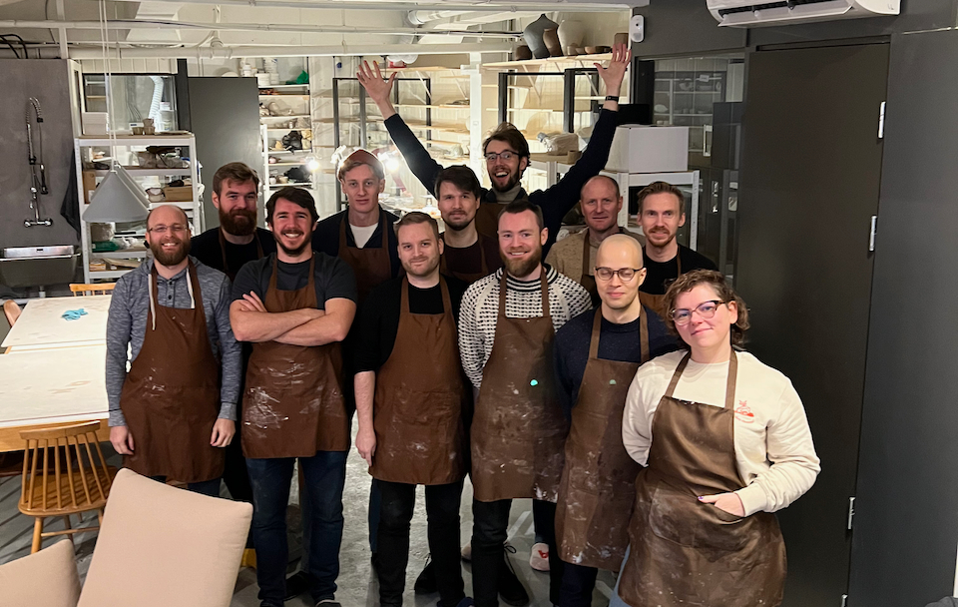
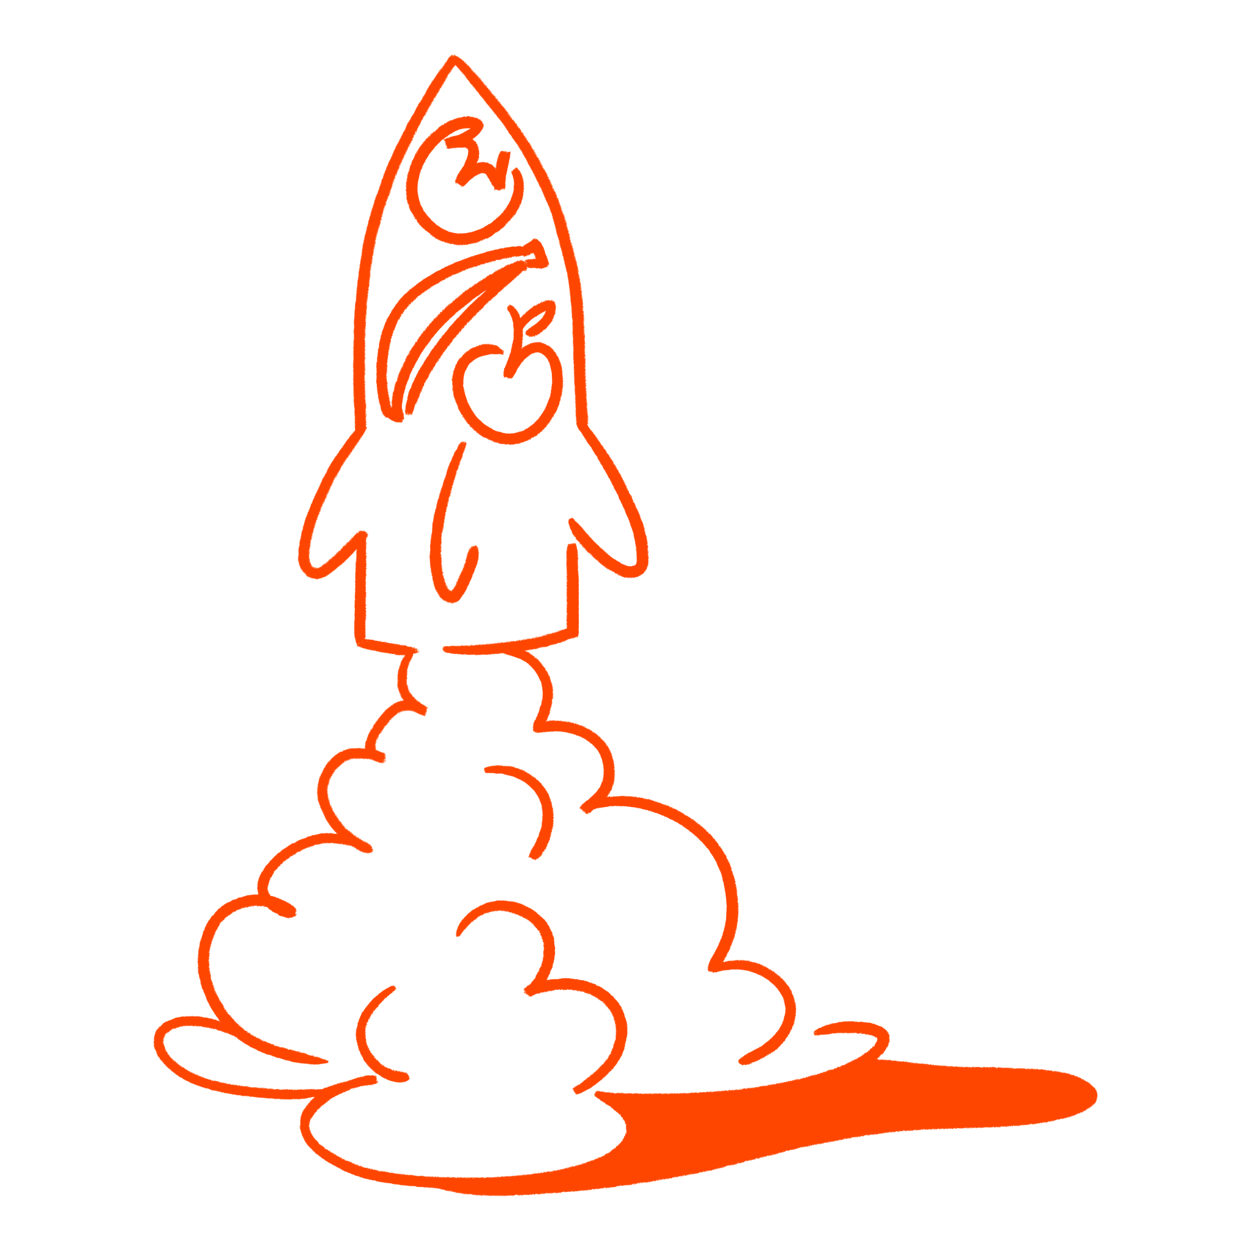
We are Oda’s Digital Janitors
Notes:
Say who we are.
Torvald
Øystein

Slide 4
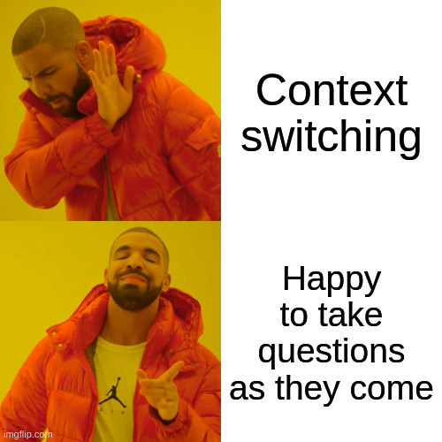

Slide 5
Briefly about us and the internals of Oda

Slide 6
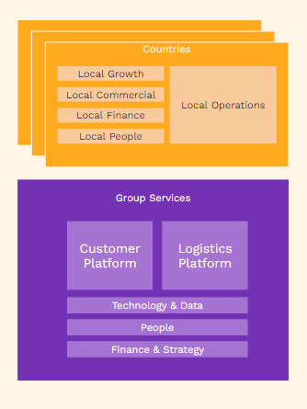
Oda from above
We are here
Notes:
Oda from a birds eye perspective by now multiple companies.
We have one «Global» organization, where we work, and then there are organizations in each of the countries we operate.
At this time we operate in Norway, Finland and Germany! Germany just launched, so that is exciting.

Slide 7
Technology & Data Platform consists of 3 teams and 35 people
12
10
13
Infrastructure & Developer Experience
Data & Insight Platform
Organizational Engineering
Cloud infrastructure
Reliability engineering
Networks
Data platform
Distributed data ownership
Training and knowledge-sharing
Shared tooling
Technical integration
Security and Privacy
Sites and Devices
Notes:
We are here. We’re supporting around 100 developers.
There are about 200 active users in Grafana. 500 in total.
Number of employees in Oda by now is around 1500 people, including warehouse operators and drivers.

Slide 8

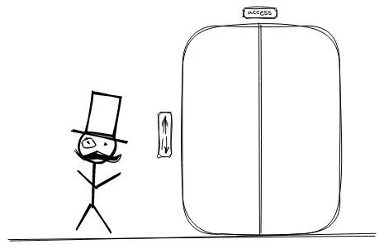





“We sell onions on the internet, and much more”
Notes:
What do we do?
We sell onions on the internet, and much more. For those of you who read Hacker News, you’ve probably heard of this «I sell onions on the internet» blogs post. Good read.
We do the same, but we also sell thousands of other products, and we do this with by using
Google Cloud
Terraform
Kubernetes
A zero trust architecture
Mostly python
And with a bias of building stuff ourselves instead of buying off the shelf products

Slide 9
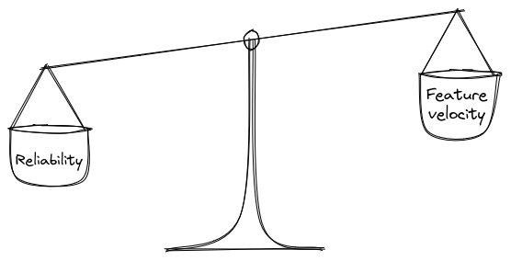
TLDR;
Make SLOs. Even the process is worth it
Give it time. Keep talking about it
Combine error rate and latency
Measure from the outside
Try to capture user pain
Alert on symptoms not root cause
Keep it simple
Use your error budget
Keep your focus

Slide 10
The Why?
Why do Oda care about SLO’s? Because it is part software delivery performance
Notes:
Right, intro out of the way. Why this talk?? Why should anybody care? As many others we care deeply about our software delivery process. We will not spend any time trying to convince anybody that caring about that is important. Far to many much smarter people have spent time on that, and I assume that you are convinced. So, as you might have guessed, the SLO focus is part of this larger thing that we call the software delivery process. So as part of the why section I will introduce the different elements that we track. I will be quick. I promise.

Slide 11

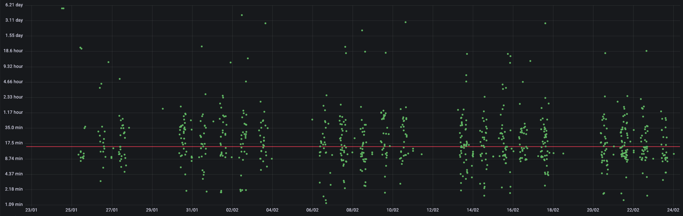
Software delivery
Lead time for changes
(Time from `merge to main` to `deploy is done`)
Notes:
Here are some of the metrics, that we use to measure our software delivery performance. Heavily inspired by the accelerate book / dora metrics.

Slide 12
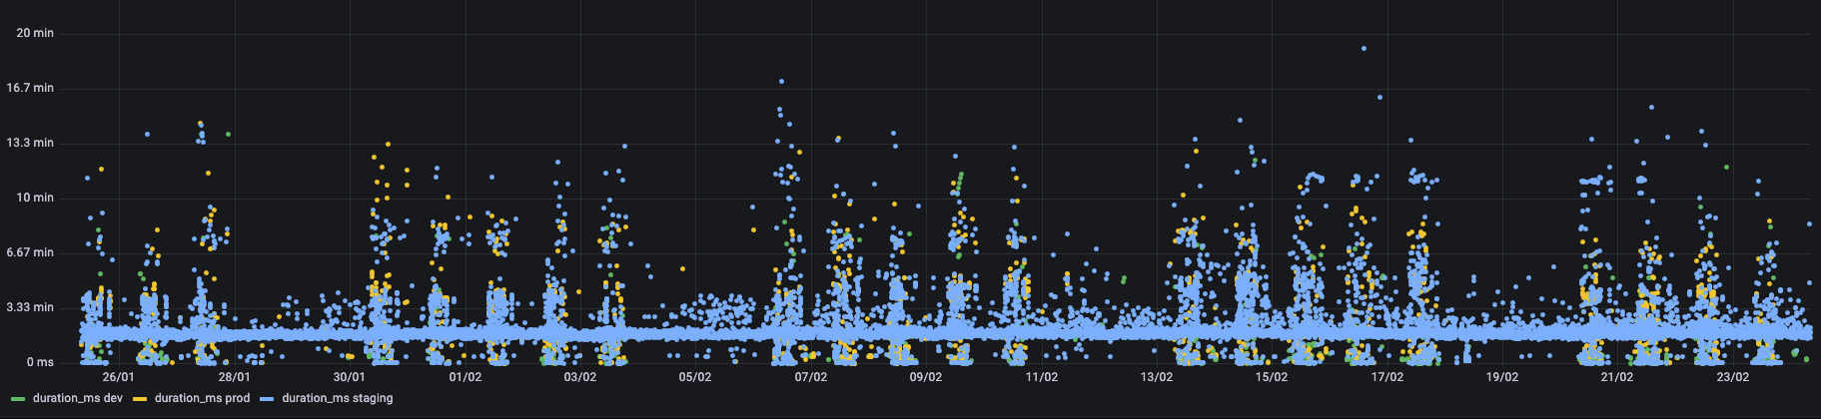
Software delivery
Deployment frequency
Notes:
Here are some metrics. Heavily inspired by the accelerate book / dora metrics.

Slide 13
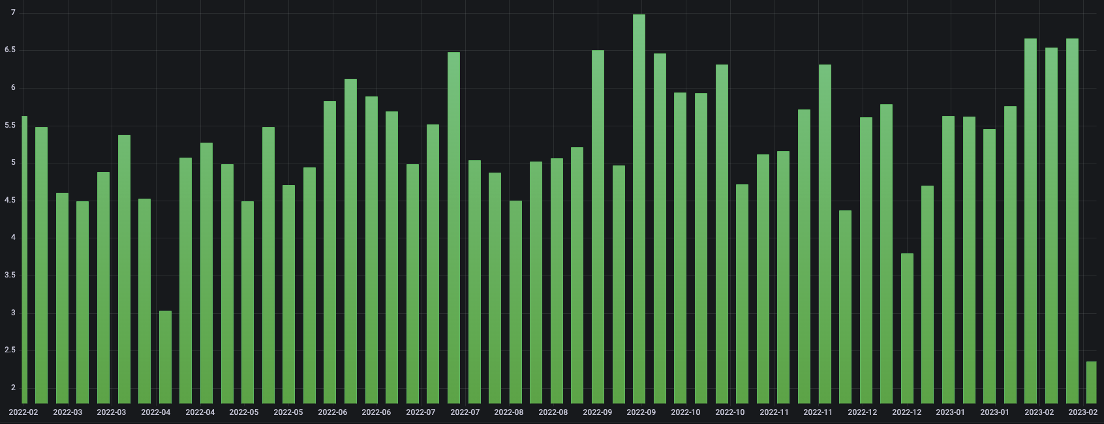
Software delivery
Merge frequency
Per week ~550 merges / ~110 distinct devs
Notes:
This is a very new metrics in our land. We have not actively tracked it or spent to much time talking about it. But we wanted to plug it here for 30 sec. Come talk to us later if you find it interesting, we are looking for others that might be interested in reasoning around this metrics. It is the number of Merges (to main) per week per developer. It says something about the experience a dev has inside the oda software delivery process. Enter SLO

Slide 14
Software delivery
MTTR???
(Mean time to recovery)
Change failure rate??
Notes:
What about these?? Surely they are things to track?? The book says so. Enter the void report. There are some newer research on this that claims that aggregating the MTTR will not give you anything meaningful to track and optimise as the varians in the numbers are just to big. The way that we look at these is that these things do not foster a bigger appetite for risks. Enter SLO

Slide 15

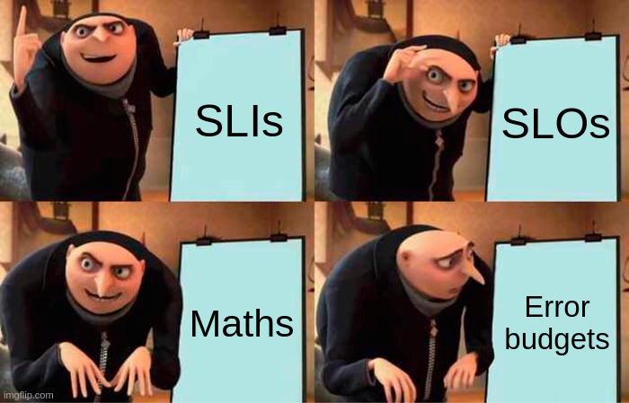
Software delivery
SRE
=
Site Reliability Engineering
Notes:
Inspired by chapter 4 in the SRE book. Our thinking is that creating SLO and paying attention to them and a health consumption of error budget is the next (dare I say final) piece in the tracking and measuring the software delivery process / performance.

Slide 16
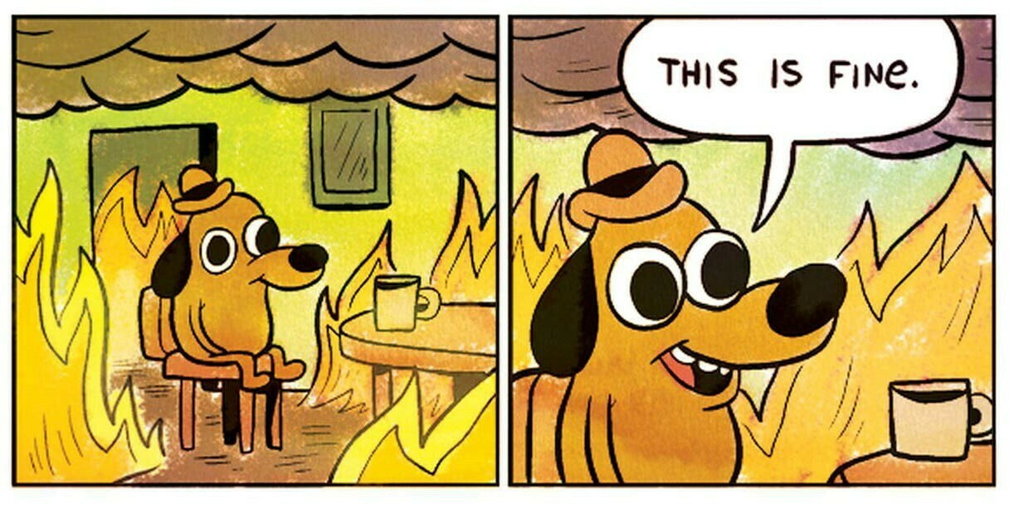
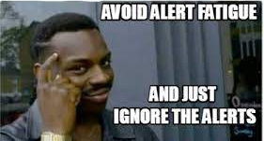
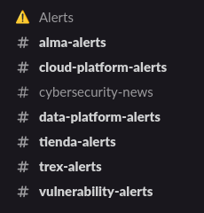
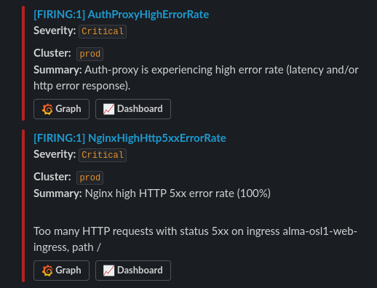
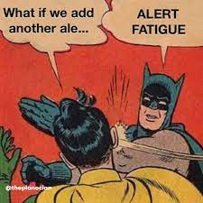

One more “why” thing
Alert fatigue is real… am i right or what?
Engineer

Slide 17
The how
How do Oda work with SLOs?
Notes:
Right, the way out the way.

Slide 18
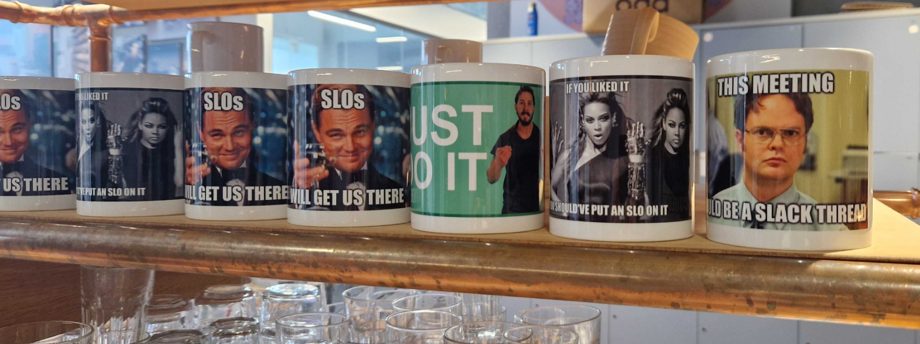
Merch is a must - always start there
Notes:
But seriously. Bringing SLO into everyday use is a long ball game. Use all the tools in the shed. Make massive deal out the small things to get stuff moving.

Slide 19



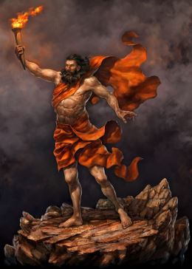

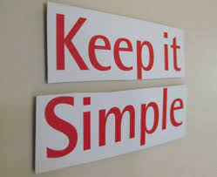

Observability tech stack
Notes:
You also need some tech components.
Prometheus titan god of fire is central in our observability stack. Us use the prometheus operator allowing for the metrics collections configuration throught the service monitor, also gives us the alert and recording rules type/objects in kubernetes. The sloth framework is doing good job of reducing the complexity that we expose the devs to around the SLO’s. We will duck into the weeds a bit soon.
We then use the full grafana stack. Logs, traces and metrics. Keeping things simple is worth mentioning here, because when creating the SLO’s it is very easy make them a hell of a lot more complex than they could be. We try really hard to only build our SLO’s on the data that we have in these systems (metrics, logs, traces)

Slide 20
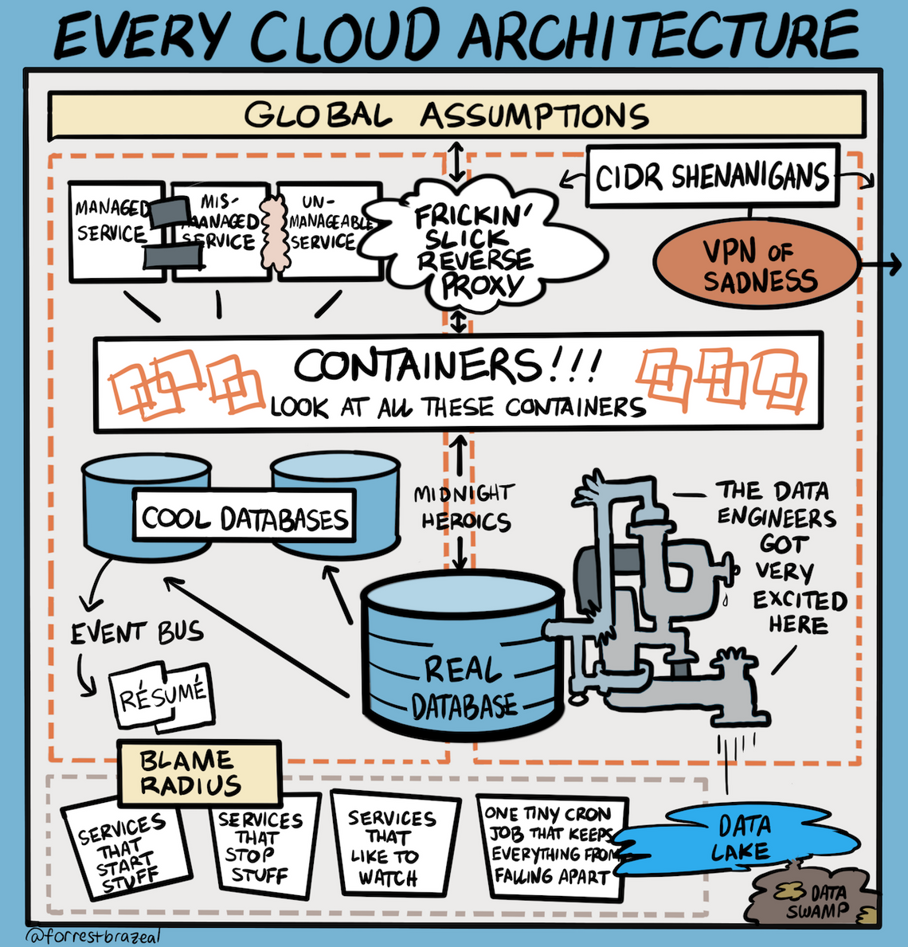
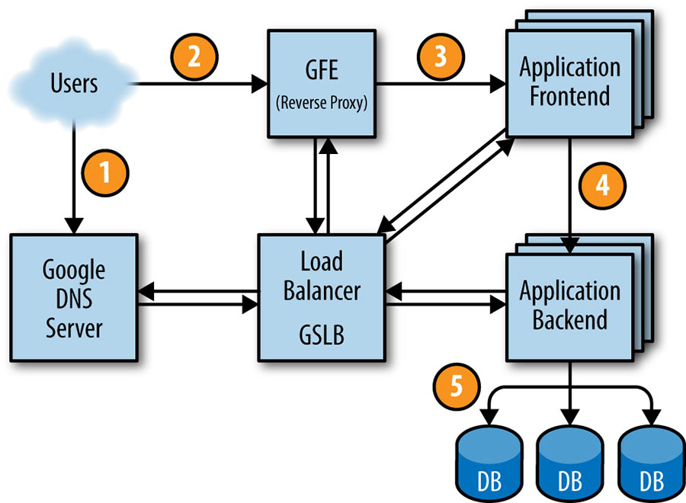
Measure close to your users
Multiple things can fail
Google SRE book
Notes:
In your infrastructure, a thousand things can fail.

Slide 21
Service Level Objectives
🤓
Notes:
I’ll just say SLO a lot from now.
Lets defined it.

Slide 22
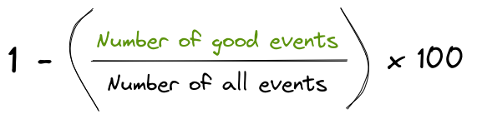
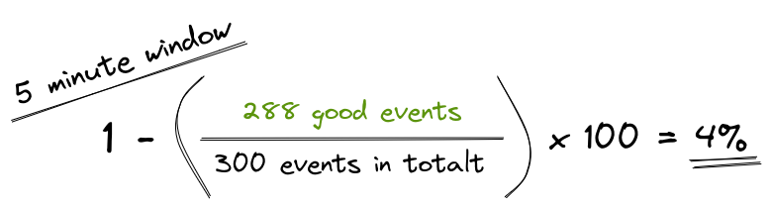
Error rate (SLI)
SLI: Service Level Indicator
Notes:
At the heart of an SLO

Slide 23
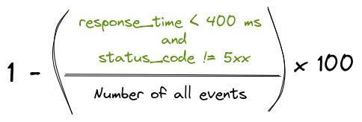
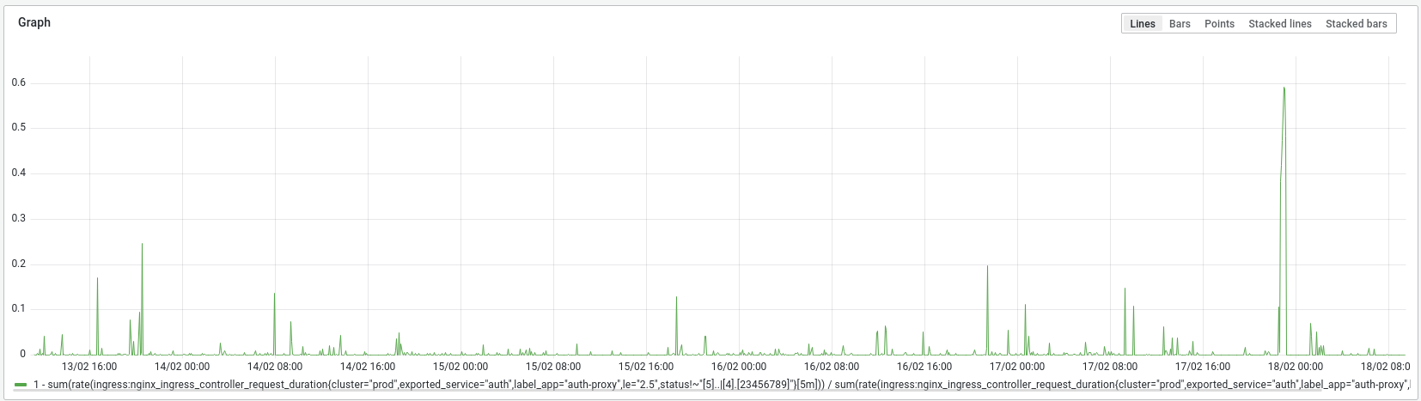
Error rate example
Notes:
Here is an example of our authentication proxy, its a web service.

Slide 24
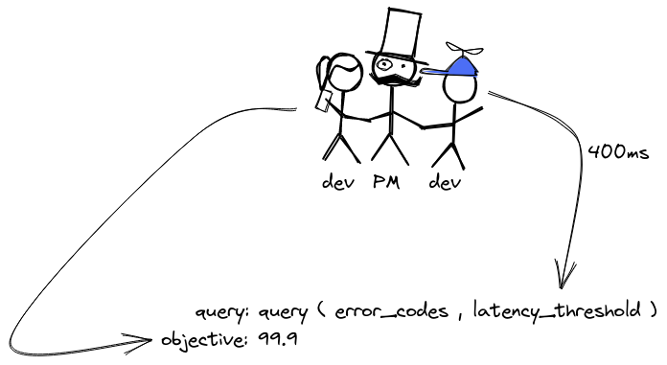
Levels of objectives are typically:
99.9 (Monthly failure budget: 43m 49s)
99.5 (Monthly failure budget: 3h 39m 8s)
99 (Monthly failure budget: 7h 18m 17s)
Setting the objectives
Spoiler alert: You can afford more than you think.
Spoiler alert: You can afford much more than your boss thinks.

Slide 25
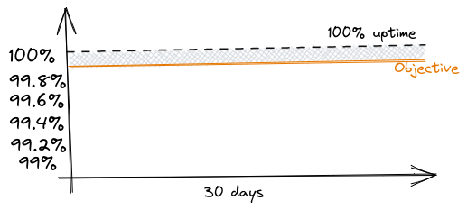
Objectives
Notes:
30 days
Error budget

Slide 26
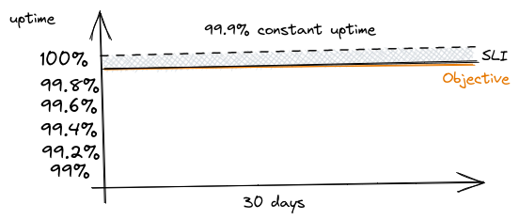
Constant error rate
Notes:
If you run on a constant error rate of 0.1 %

Slide 27
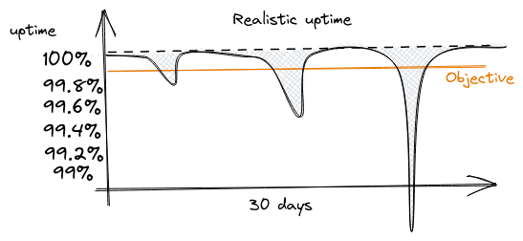
Error budget
Burn
Notes:
Right, so with the error budget in somewhat defined and agreed. How is this consumed??

Slide 28
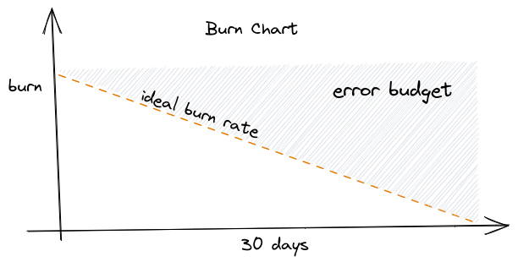
Burn chart
Notes:
Right, so with the error budget in somewhat defined and agreed. How is this consumed??

Slide 29
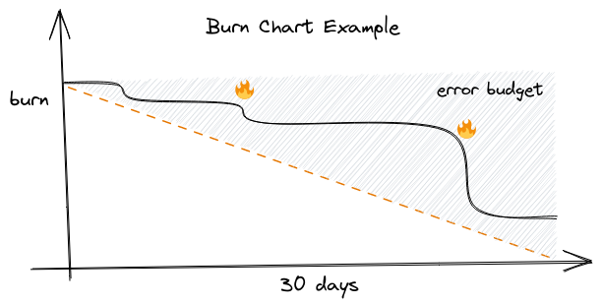
Burn chart example
Notes:
Right, so with the error budget in somewhat defined and agreed. How is this consumed??

Slide 30
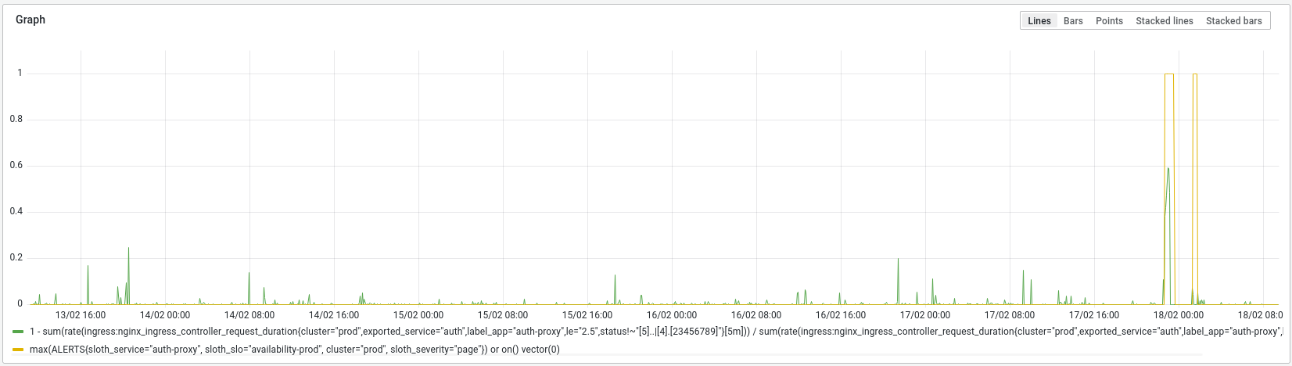
Error rate example

Slide 31
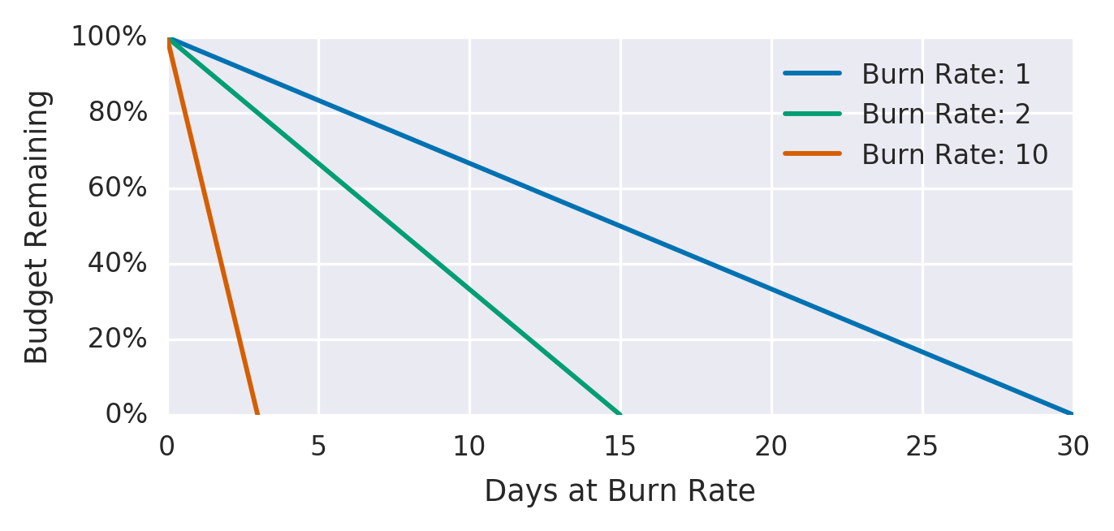
Burning our error budget

Slide 32
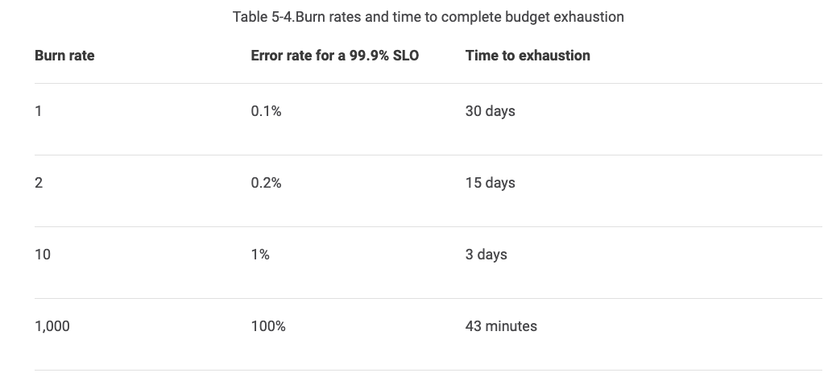
Burning our error budget

Slide 33
Why use sloth?
It hides / helps out with a fair amount of complexity around building and managing the SLOs.
Notes:
Right, so why use Sloth and how does it look when you create an SLO using the SLOTH framework?

Slide 34
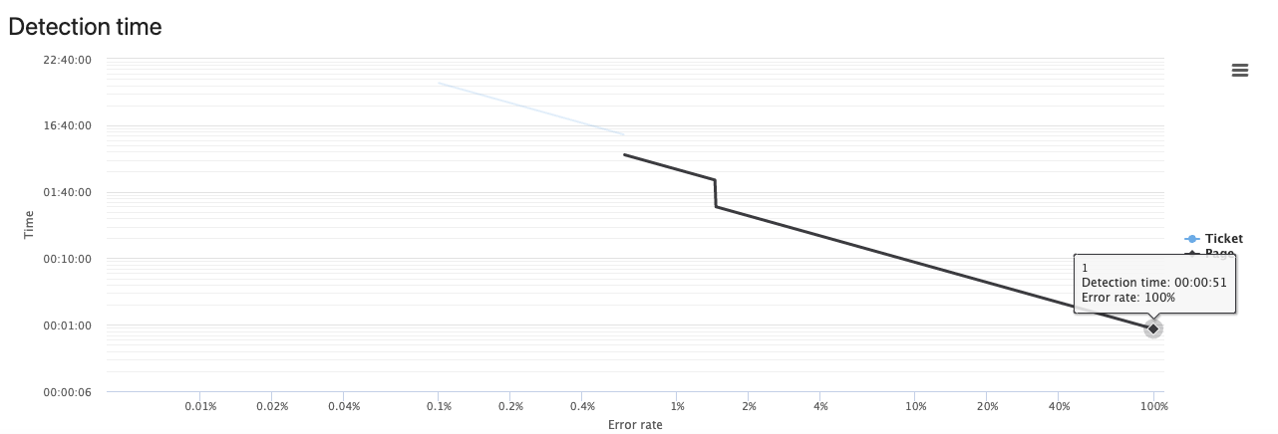
When does the alert trigger? An example with a 99.9% objective
Notes:
It depends on the uptime agreement
https://uptime.is

Slide 35
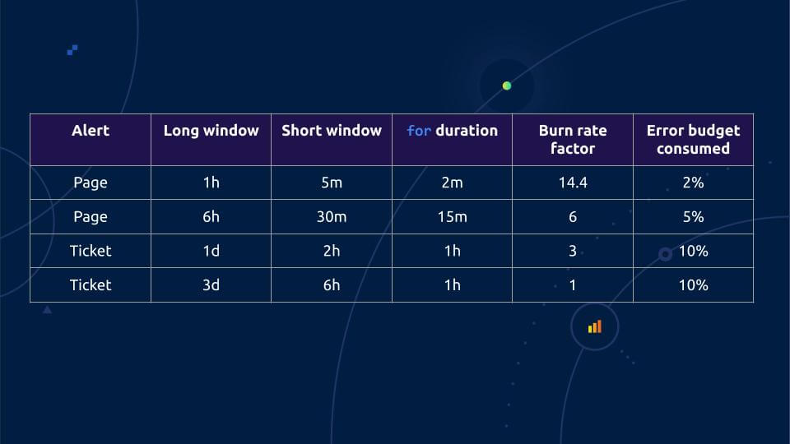
Resources

Slide 36
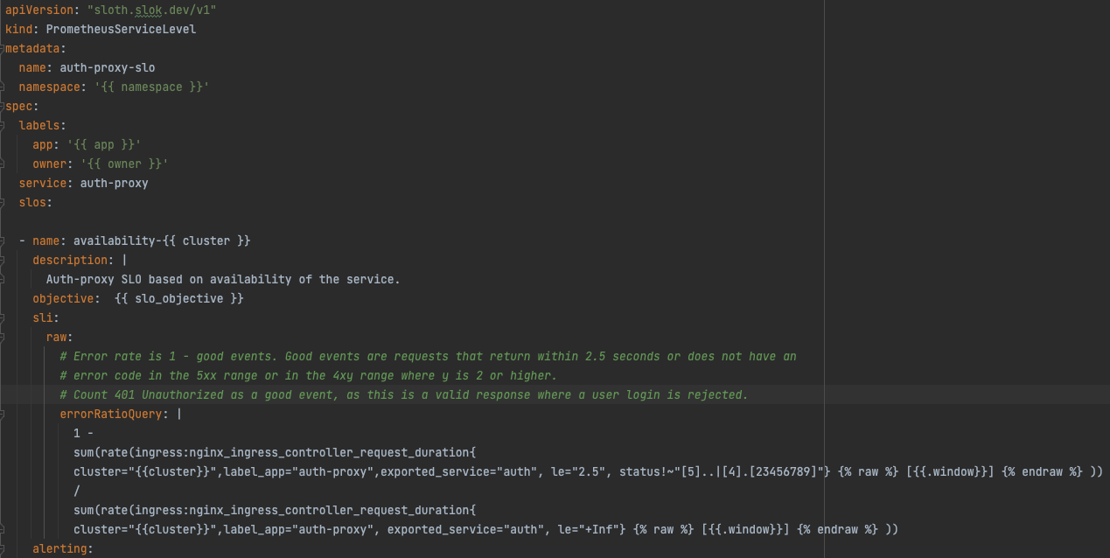
Let’s have a look at a sloth SLO
Notes:
By describing a SLO. Much like more general alert rule.

Slide 37
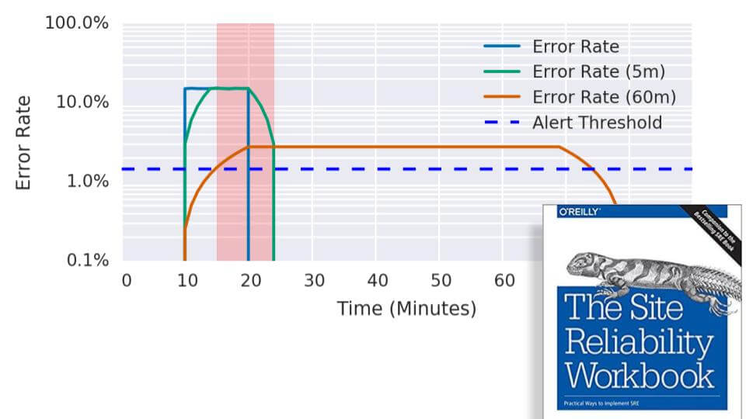
Multiwindow, Multi-Burn-Rate Alerts
Notes:
“The blue curve is the actual error rate as it happens,” he explained. “So at T plus 10 minutes you have an outage for whatever – a few instances of your microservice go bad and you have like a 15% error rate. What happens? The red line is this one hour average. So it takes five minutes for this red line to go above the 1.44% error threshold. So after five minutes, even with this partial outage, you get a page. Presumably the engineer on call wakes up, fixes the problem within five minutes, good engineer. Error rate goes down to zero, engineer goes back to bed.”
The problem, though, is that the red line will stay above the threshold for an hour because this error peak is in the one-hour average. The alert fires all that time. You might be tempted to snooze it on Pagerduty or silence the alert in Prometheus. But then if something else happens, and the error spike happens again, the alert has been silenced and no one will be notified.
So how can you make sure that if the outage returns, the alert will reset quickly? “You take the five-minute average, and this is where the short window from the table enters the game,” Rabenstein said. “For the long window of one hour, you take another window of five minutes, and you also calculate the average error rate.”
Alerting on that alone would be too noisy; a few error spikes shouldn’t trigger alerts. “But if you alert on both curves being above the threshold, then you get the best of both worlds,” he said. “This pages here because both green and red are above the fold, and once you have fixed the outage, the green curve will go down really quickly. So from this moment on, your alert ceases to fire. The red area there is when the alert is actually firing, and that’s exactly what you want.”

Slide 38
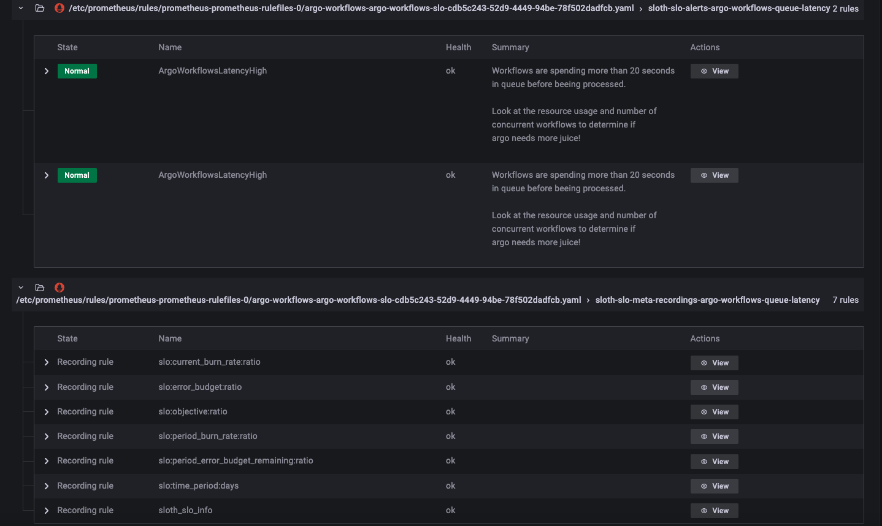

Slide 39
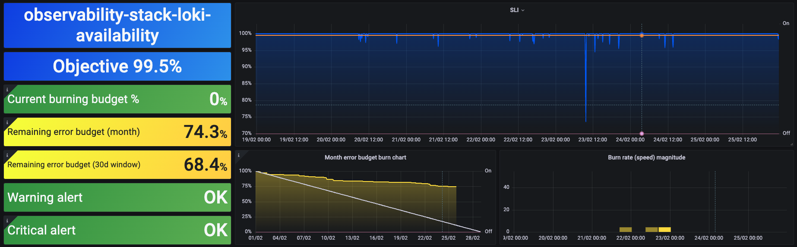

Slide 40
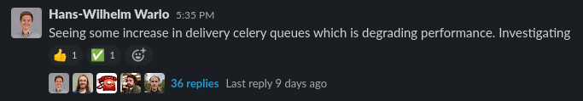
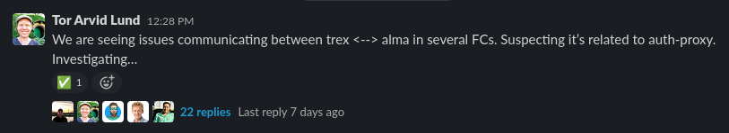
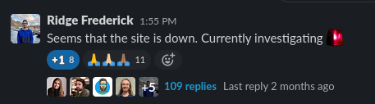
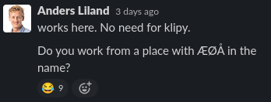
Real Oda examples
«Have you tried not working from Gjøvik?»

Slide 41
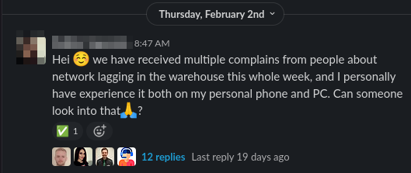
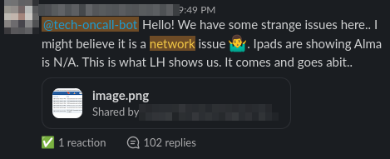
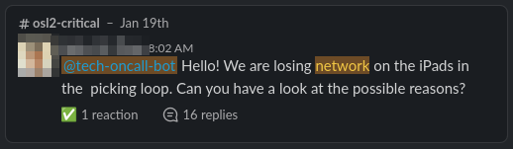

Networking
The the burden of proof on the networking team
Notes:
Some of these problems are network problems!
Or are they?
They are at least jumping a lot to conclusions. We need to quickly triage network problems. And keep errors to a minimum.

Slide 42
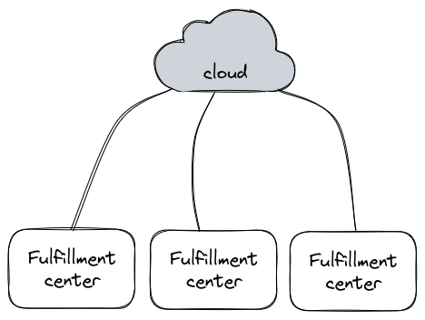
Networking
Notes:
Fulfillmentet center = warehouse

Slide 43
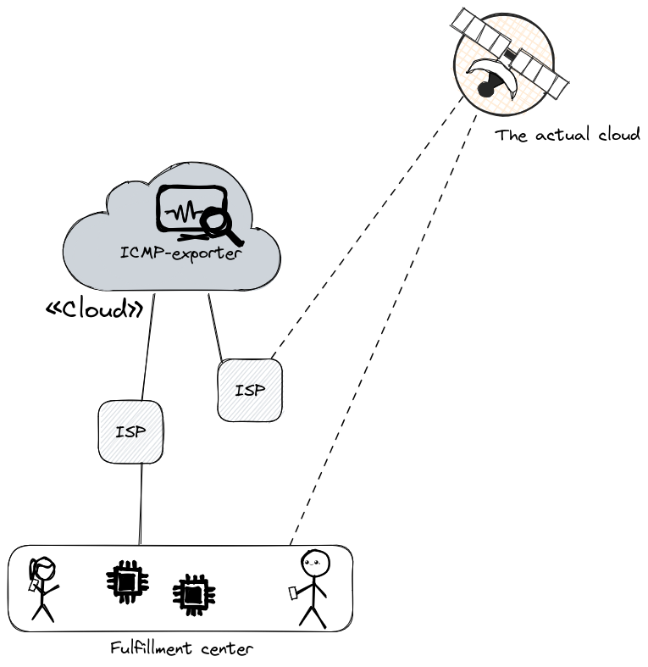
Networking

Slide 44
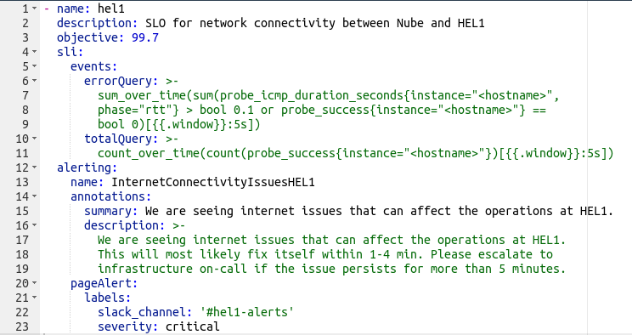
Networking
100ms round trip
A package loss is also included here as a timeout
Communicate directly to users

Slide 45
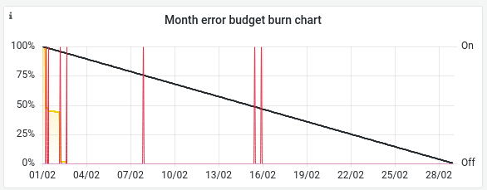

Networking
February
BER1 👎 OSL2 👍

Slide 46

Networking

Slide 47





The webshop
App components
Product fetching
Frontpage
max(shop-SLOs)

Slide 48


Logistics

Slide 49



Monthly Service Review
Collective review once a month

Slide 50
Where to start
20% tech
80% politics

Slide 51

Play the long game
We have talked about this for years
Alienating
You need the underlying data
Teams need to have available headspace
It’s really intuitive to monitor root causes
Do it on your own stuff first, lead by example
Go out there and talk with people!
To developers
To product managers

Slide 52



Other learnings
Loki based SLO
Logs -> metrics -> SLO error rate query
A denominator adjusted SLI type
https://github.com/slok/sloth/pull/459
Might not work for low traffic services
Nudge people to use their budget!
The «Gjøvik problem»

Slide 53

Hope this helps!

Slide 54
TLDR;
Make SLOs. Even the process is worth it
Give it time. Keep talking about it
Combine error rate and latency
Measure from the outside
Try to capture user pain
Alert on symptoms not root cause
Keep it simple
Use your error budget
Keep your focus

Slide 55

Resources
https://uptime.is
https://wpjunior.github.io/multi-burn-rate-calculator/
How to Include Latency in SLO-based Alerting - Björn Rabenstein, Grafana Labs
https://sre.google/workbook/implementing-slos/
https://sre.google/workbook/alerting-on-slos/

Slide 56


Slide 57

Thank you
Contact:
oystein.pettersen@oda.com
torvald.lekvam@oda.com

Slide 58


